Slide 1
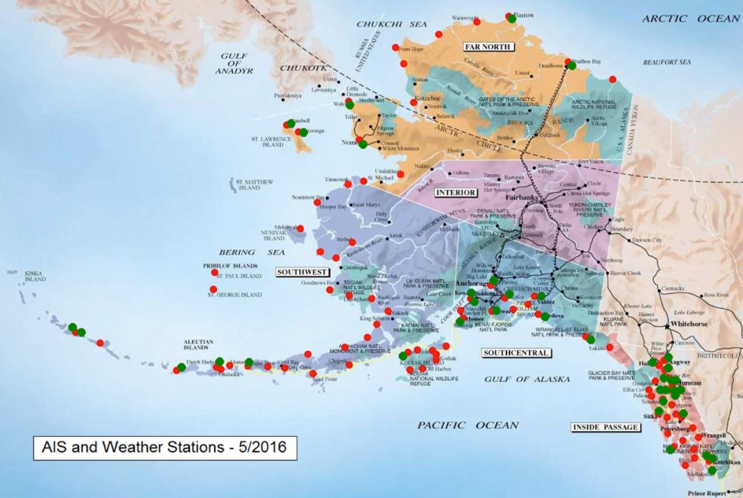
Marine Exchange of Alaska Real-time access to weather observations for mariners through AIS
Installation of weather systems with
AIS stations
Primary goal is to transmit real-time weather through AIS directly to vessels and mariners to improve maritime safety
Data also available through AOOS data portals and NDBC
NWS utilizes data for forecasting
2020 IOOS Fill the Gaps Campaign
Supporting up to 6 new Arctic WX sites
CONSIDERATION: Requires off-grid power across
much of Arctic
Notes:
The MXAK operates the AIS network for Alaska and the U.S. Arctic.
AOOS has been working with the MXAK for a number of years to co-install weather stations alongside AIS receivers and transmitters
Current focus is on increasing WX obs in western AK and the Arctic.
Weather data are provided RT to mariners via the AIS, as well as thru the AOOS data portals and NDBC
Marine installations such as those from NDBC buoys, are non existent north of the southern Bering Sea.
So NWS forecasters utilize the data that help fill gaps in the region
Data also provide back ups to FAA weather stations in some of the more remote AK villages.

Slide 2
FILL THE GAPS FUNDING FY18 Board Approved $50K to MXAK to help install NE Cape AIS/WX installation
Original proposal was for installation of an AIS Receive/Transmit and WX Installation on NE Cape of St. Lawrence Island (estimated install cost $100K)
After some careful evaluations, the NE Cape option was estimated to be cost prohibitive without substantially more funding
“It has the potential to be the most expensive AIS/WX station in Alaska.”
(Ed Page, 24 Sep 2019)
Communications (satellite) costs several thousands $$ annually alone
Long-term O&M costs are expected to be high for service and operations
Local community support was not as high as previously implied
According to NWS, the existing Gambell and Savoonga AIS/WX and FAA Wx at airports satisfy the NWS need
Locals and Brian Brettschneider from NWS/Fairbanks suggested SE on SLI better
Notes:
Local Support: We found local interest in a weather site at East Cape was lukewarm and there was
more interest in a weather site at the southeast region of the Island.
When and if a site is identified, support from locals to
assist in transportation, inspect, possibly winterize and service the site is needed to ensure reliable
operation.
Technology Challenges: We determined a communications capability to transmit the wx data back
from the sensor to the AOOS and MXAK data dissemination systems will be a costly and significant
challenge due to the location of the island -- projected operating costs for the satellite comms will
approach several thousand dollars annually in addition to high servicing and maintenance costs.

Slide 3
MXAK offered alternative proposal in September 2019 Install 3 (up to 6) weather stations and AIS Transmit capability in gapped areas of the Arctic
Challenges of locating suitable sites and hosts:
Entering into MOUs/contracts with land or infrastructure owners
Permits (state, federal, tribal)
NEPA per above if on tribal community land
Costs due to location and remoteness (on grid/off grid, communications, distance from road service)
MXAK offered 6 options…Kivalina was added to the list later:
St. Paul Island
St. George Island
Point Lay
Kotzebue
Shishmaref
Point Hope
Kivalina
Notes:
Rick Thoman

Slide 4
AOOS also asked for input on priorities from NWS and ACCAP
NWS: MXAK should target sites with no existing NWS or FAA Wx observations if possible
NWS Fairbanks: Would love one on Little Diomede Island
MXAK: Purpose is to provide localized near the water obs for mariners through AIS
AOOS: Possible to put one on Fairway Rock if HFR goes there in 2020….but not certain
Location Wx already? | MXAK Priority | NWS Priority Anchorage | NWS Priority Fairbanks | ACCAP Priority | AOOS
Yes - airport | St. Paul Island | St. Paul | Shishmaerf | St. Paul | St. Paul
Yes - airport | St. George Island | St. George | Kotzebue | Shishmaref | St. George
Yes - airport | Point Lay | x | x | Kivalina | Shishmaref
Yes - airport | Kotzebue | x | x | Kotzebue | Point Hope
Yes - airport | Shismaref | x | x | Point Lay | Point Lay
Yes - airport | Point Hope | x | x | Point Hope | Kotzebue
Yes - airport | Kivalina | x | x | St. George | Kivalina
Notes:
Brett: a station at Northeast Cape from 1953 to 1968 -- old Air Force Base. Having a runway (if operable) helps for installation and maintenance.
Three climate stations on St. Lawrence Island have all been on the north side. If there's an opportunity for the south side, that
would be my preference. Northeast Cape would be great too. P.S. - I love the idea of having a station at Fairway Rock.
Rick Thoman: Little Diomeded Island:
Ed Page response: We’ve looked hard at Diomede and have always found it to be a heavy lift with little benefit to ships transiting the Bering
Strait on the U.S. side.
SLI FAA sites fail a lot, so those were welcome.

Slide 5
EXTRA SLIDES IN CASE SOMEONE WANTS TO SEE WHERE EXISTING STATIONS ARE

Slide 6
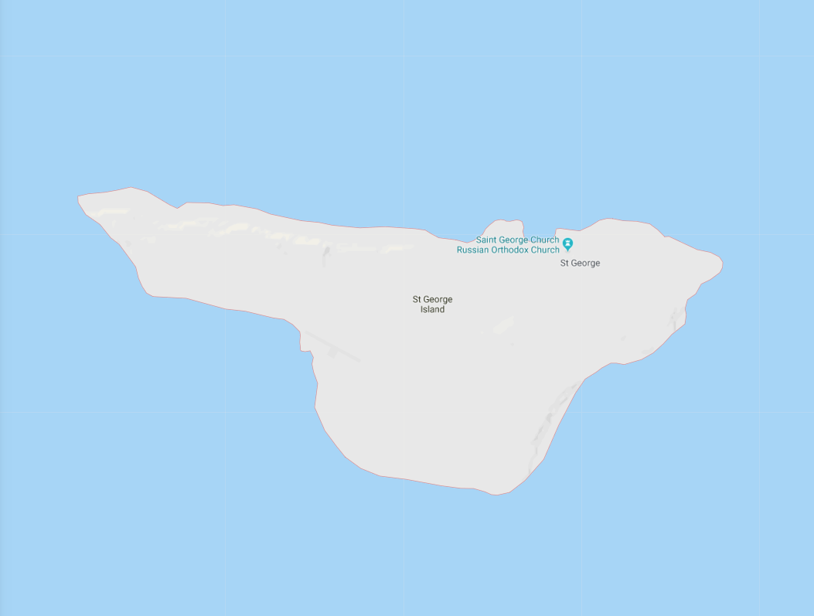
St. George Island
Proposed
MXAK Station
Notes:
Note the MXAK Site proposed is on North side of Island
FAA on South

Slide 7
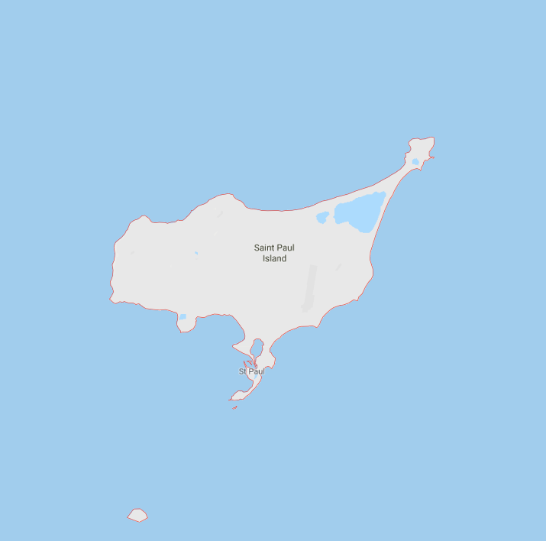
St. Paul Island
Notes:
Note MXAK Site is on South end out on spit providing very localized on water conditions
Airport is smack in the middle of the island.

Slide 8
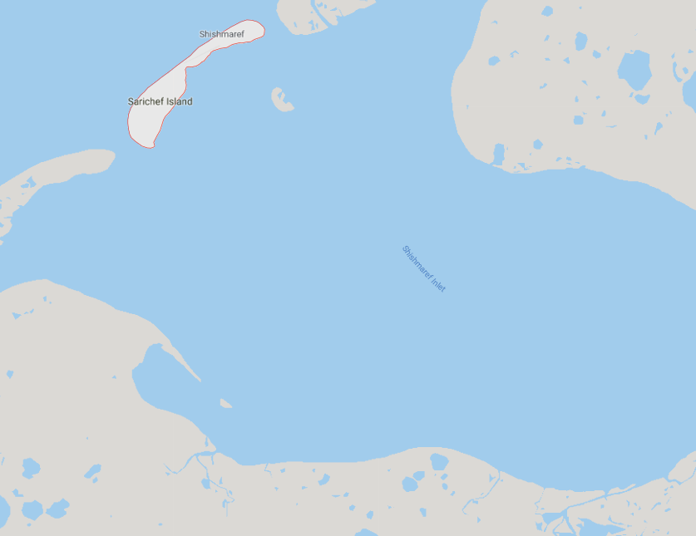
Shismaref

Slide 9
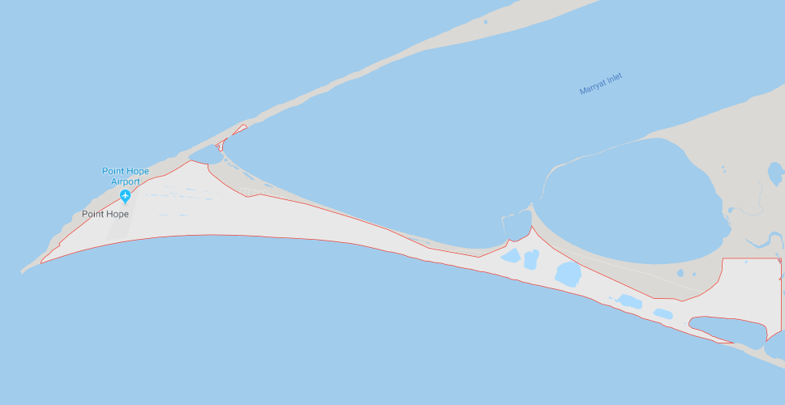
Point Hope

Slide 10
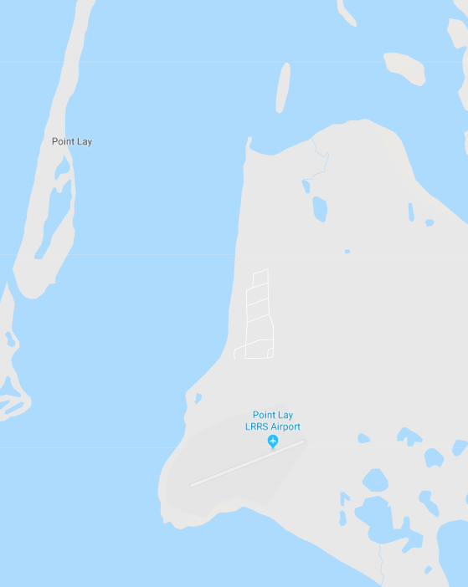
Point Lay

Slide 11
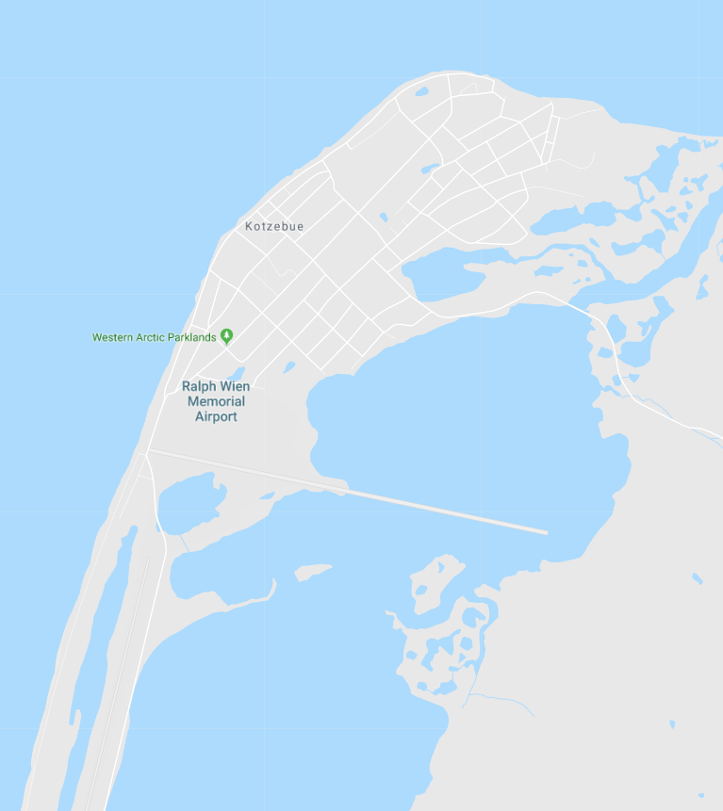
Kotzebue

Slide 12
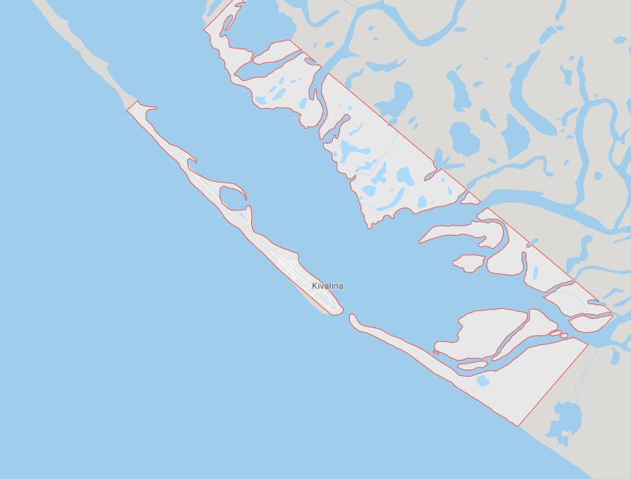
Kivalina

