Slide 1
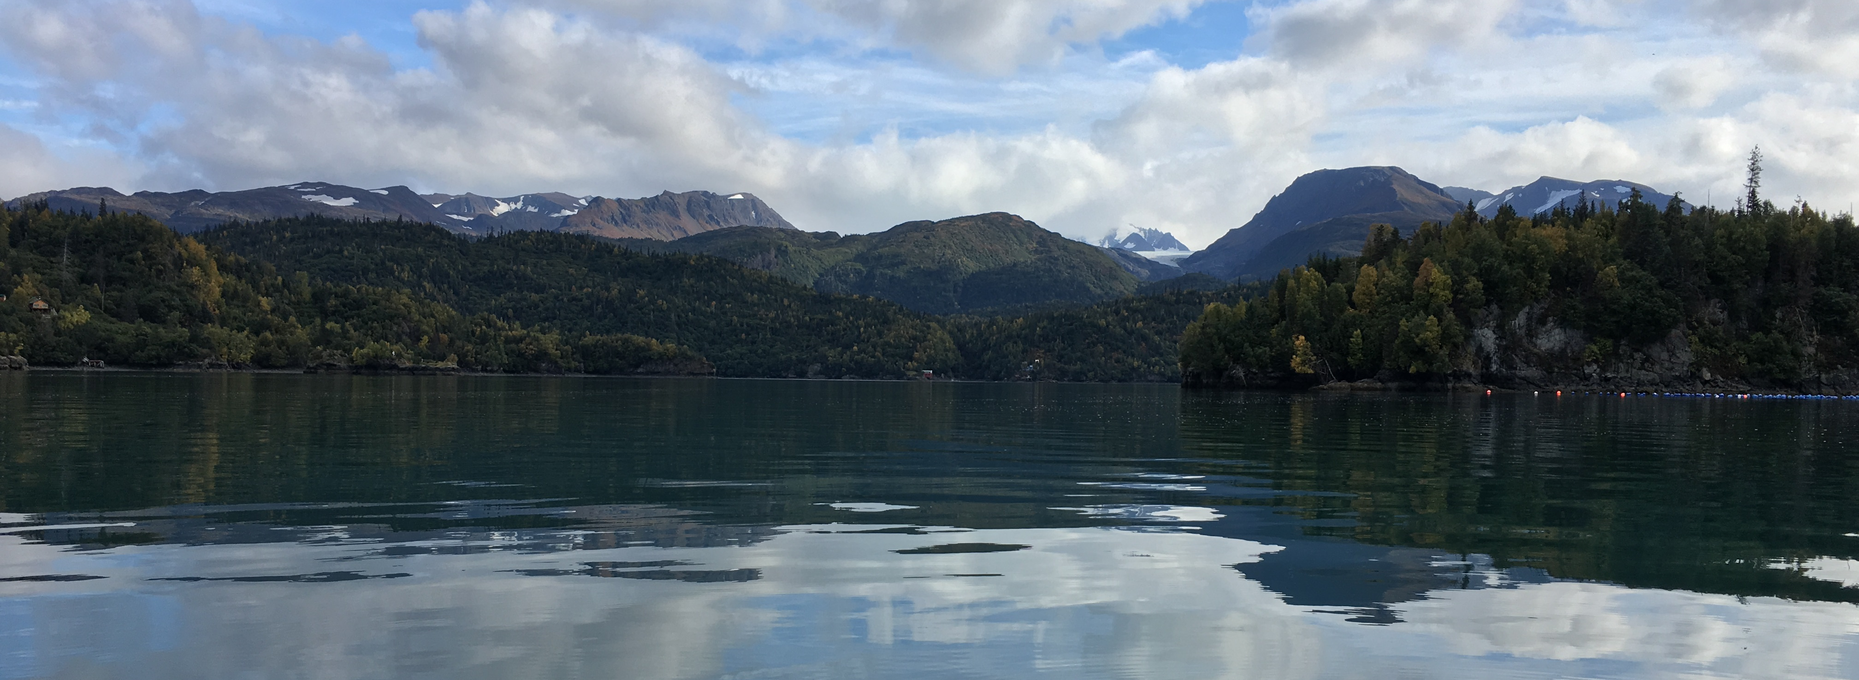
Harmful Algal Blooms in Alaska
Kris Holderied NOAA Kasitsna Bay Laboratory
Rosie Masui Kachemak Bay National Estuarine Research Reserve

Slide 2
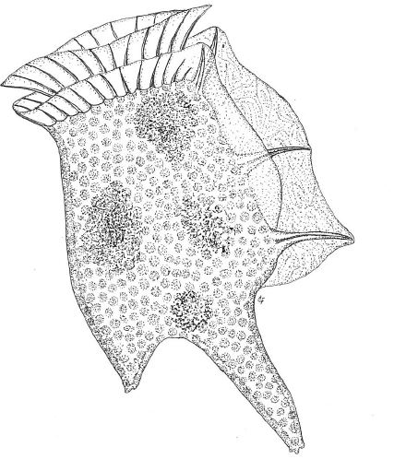
Harmful Algal Blooms
Definition
‘Harmful algal blooms, or HABs, occur when colonies of algae – simple plants that live in the sea and freshwater – grow out of control and produce toxic or harmful effects on people, fish, shellfish, marine mammals, and birds. The human illnesses caused by HABs, though rare, can be debilitating or even fatal.’ – NOAA
Paralytic Shellfish Poisoning – saxitoxins
Amnesiac Shellfish Poisioning – domoic acid
Diarrhetic Shellfish Poisoning – oxidaic acid
Cyanobacteria blooms - cyanotoxins

Slide 3
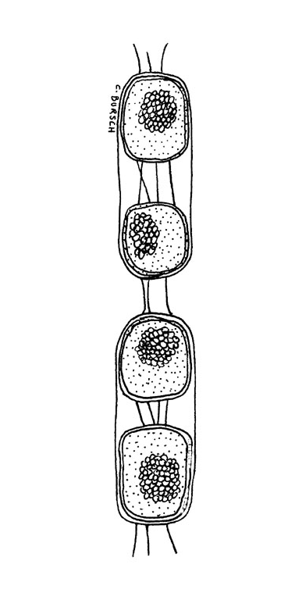
HAB species are Phytoplankton
Planktonic Algae
  Protists with chloroplasts
  Single celled – or a group of single cells
  Use chlorophyll a in photosynthesis
  Live and die floating in the water
Diatoms
Dinoflagellates
  Alexandrium (Paralytic Shellfish Poisoning)

Slide 4
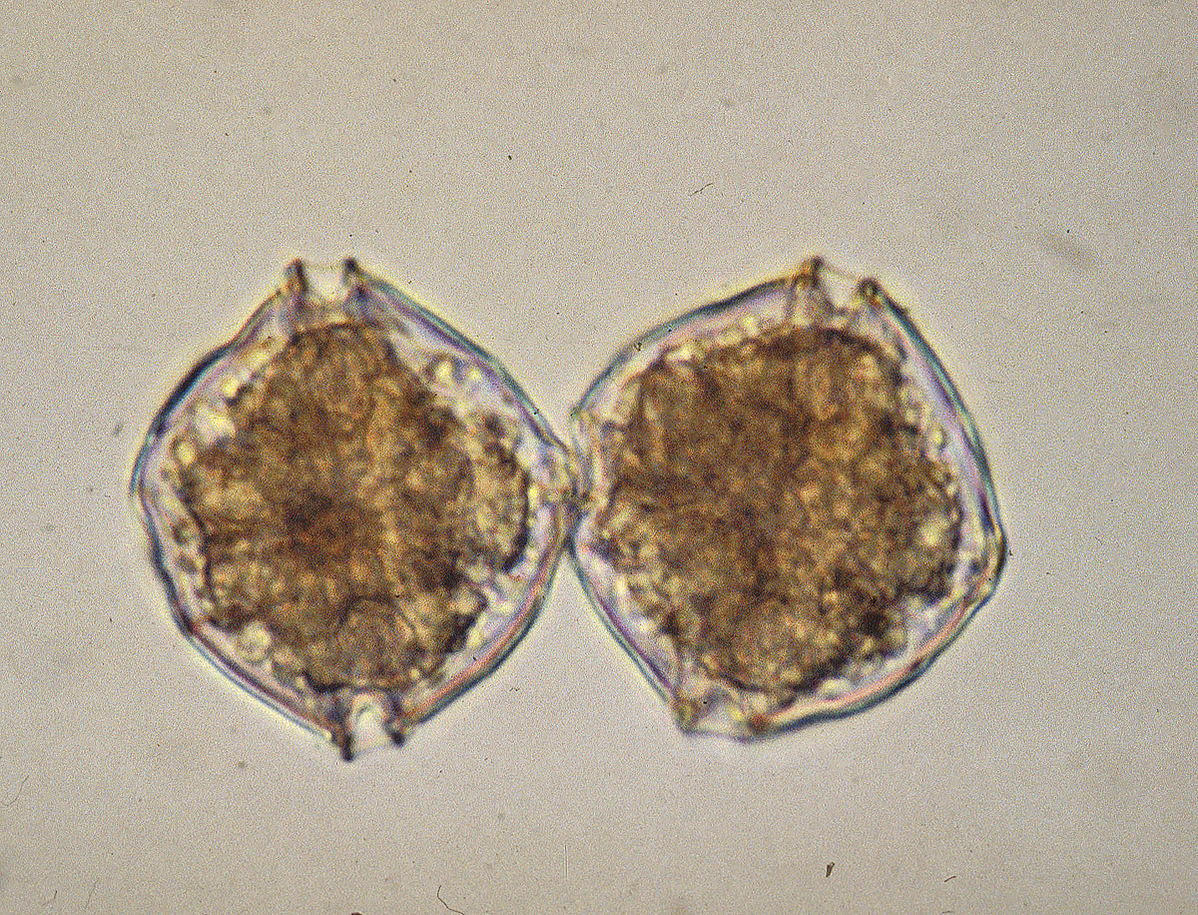
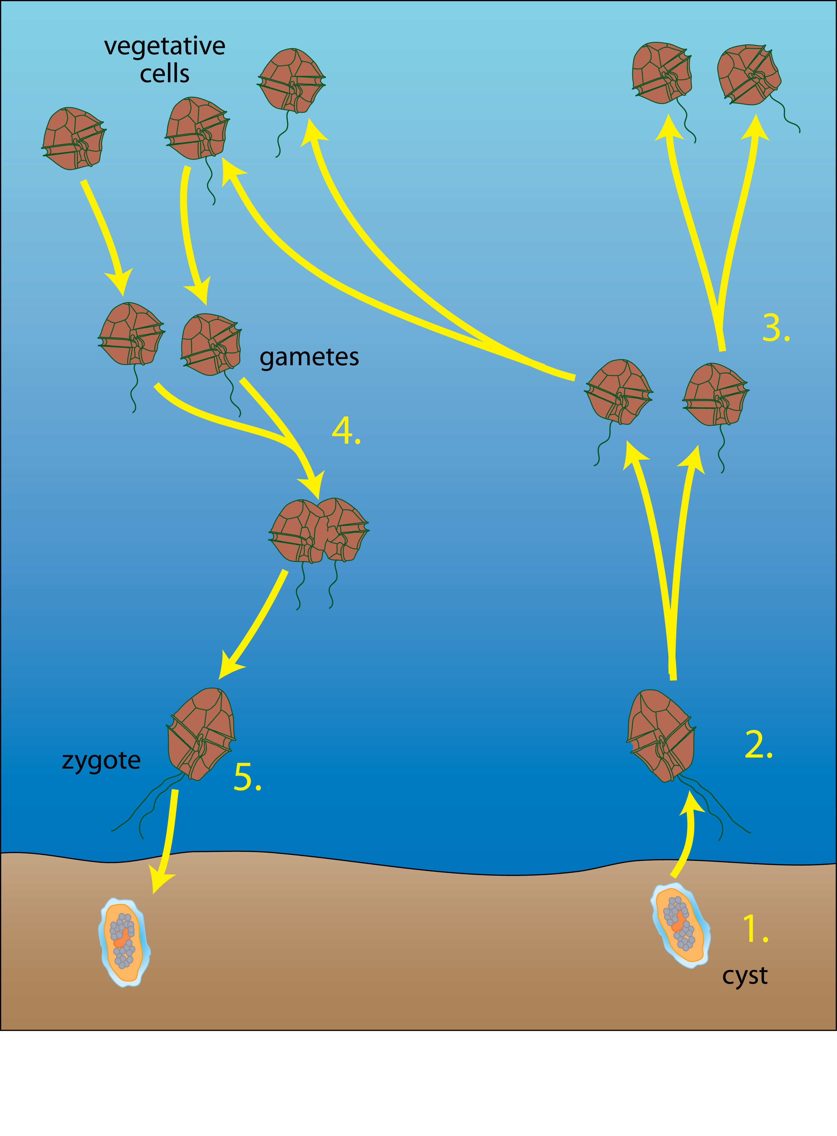
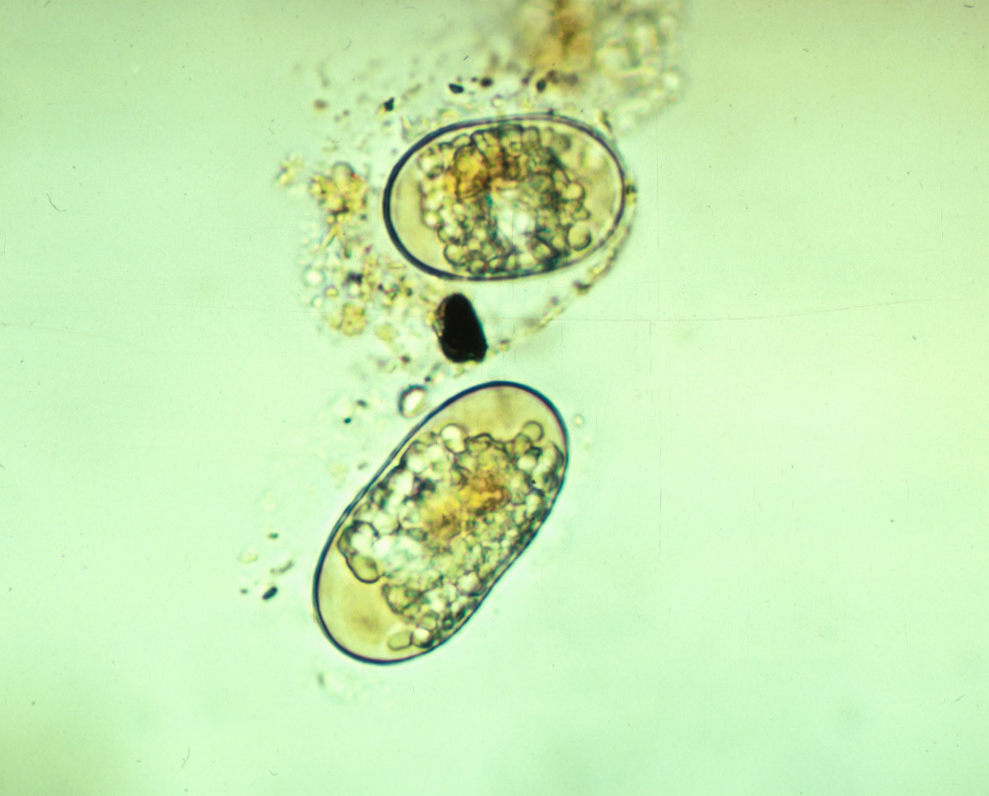
Alexandrium cells
cysts
Alexandrium life cycle

Slide 5
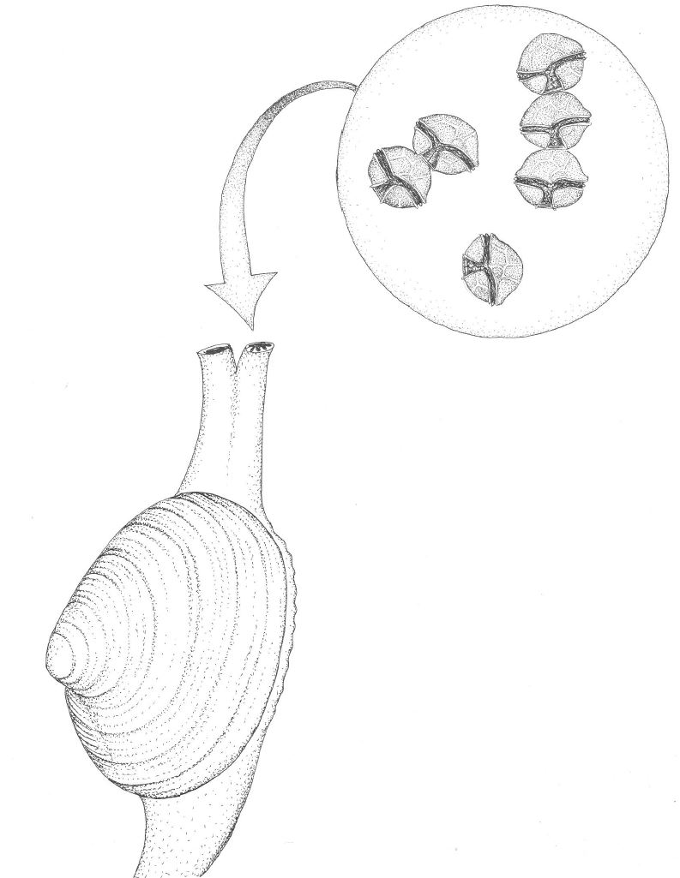
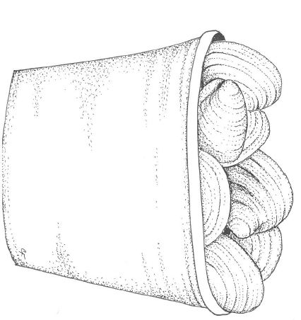
HABs in Alaska
Toxin Accumulation in shellfish
Human Consumption
Aquatic farm industry impacts
PSP!

Slide 6
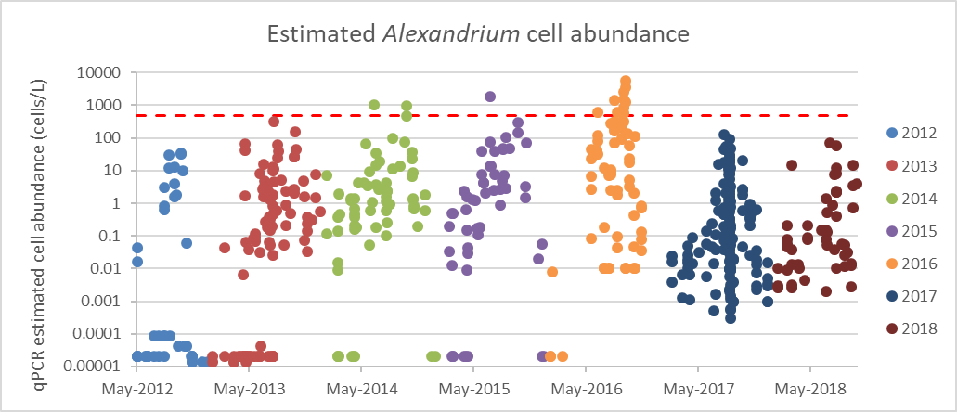

HABs in changing ocean and coastal waters
Tobin, E. D., C. L. Wallace, C. Crumpton, G. Johnson, and G. L. Eckert. 2019. Environmental drivers of paralytic shellfish toxin producing Alexandrium catenella blooms in a fjord system of northern Southeast Alaska. Harmful Algae 88:101659.
Kachemak Bay
Sep 21, 2019 WashingtonPost
Capital Weather Gang
The ‘Blob’ is surging back in the Pacific, leading to fears of mass die-offs of marine life and unusual weather patterns

Slide 7
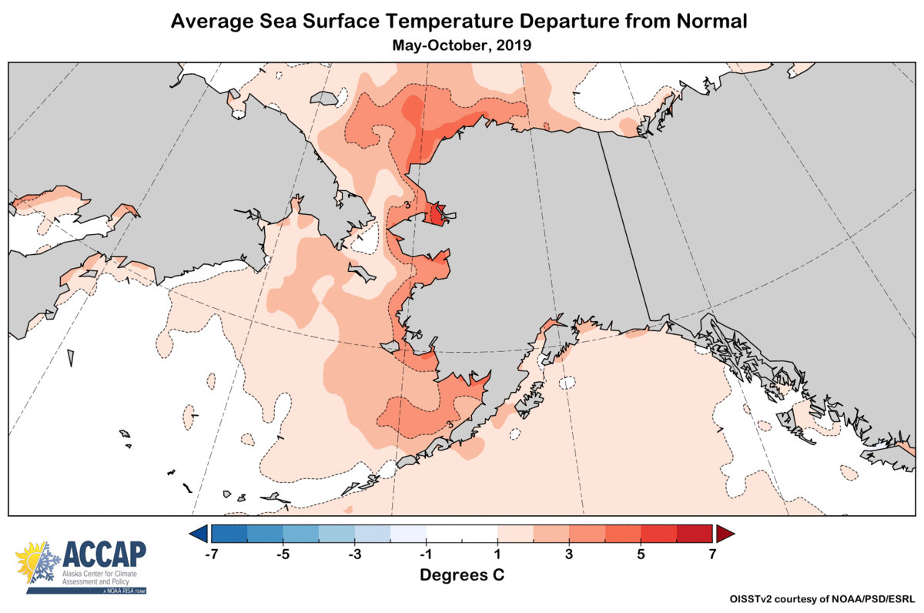
Emerging HAB issues in Alaska
Domoic acid poisoning?
Cyanobacteria?
Lefebvre, K., et al. 2016. Prevalence of algal toxins in Alaskan marine mammals foraging in a changing
arctic and subarctic environment. Harmful Algae 55:13-24.

Slide 8
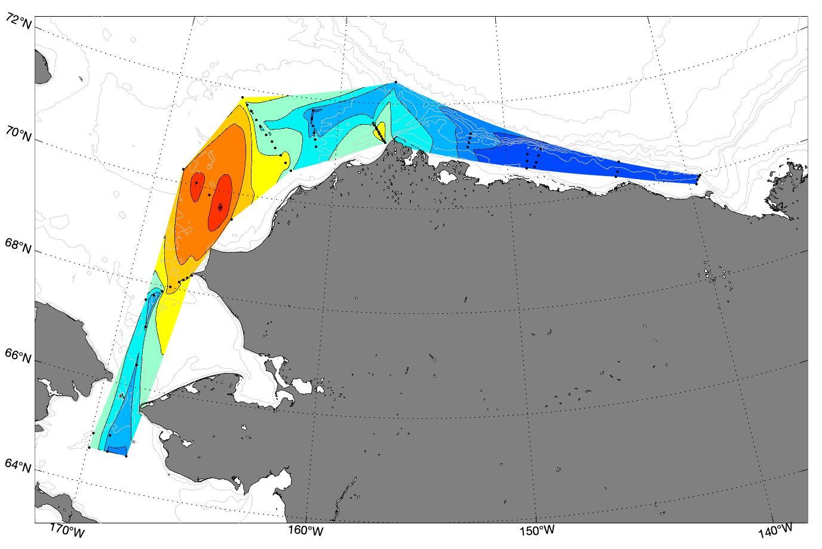
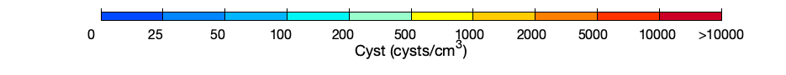
Healy 1801+ 1803 Cyst Map - 2018
Massive A. catenella cyst bed documented in the Chukchi Sea
This feature extends at least 200 km offshore and up to 600 km alongshore
Cyst concentrations (up to 11,000 per cm⁻³) are the highest ever reported for this species globally.
Positive but low cyst concentrations in the Bering Strait and Beaufort Sea regions
DBO6
Ledyard Bay
DBO2
Courtesy: Don Anderson, WHOI
Notes:
- Provide an update on major achievements/findings in FY18 and what you hope to accomplish in FY19

Slide 9
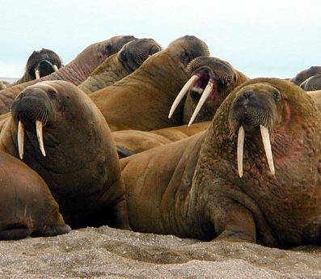
Potential HAB Impacts in Alaska
Ecosystem Impacts
  Seabirds
  Marine Mammals
  Commercial Fisheries: Crabs
  Forage species?
Subsistence Harvest
Water Security

Slide 10
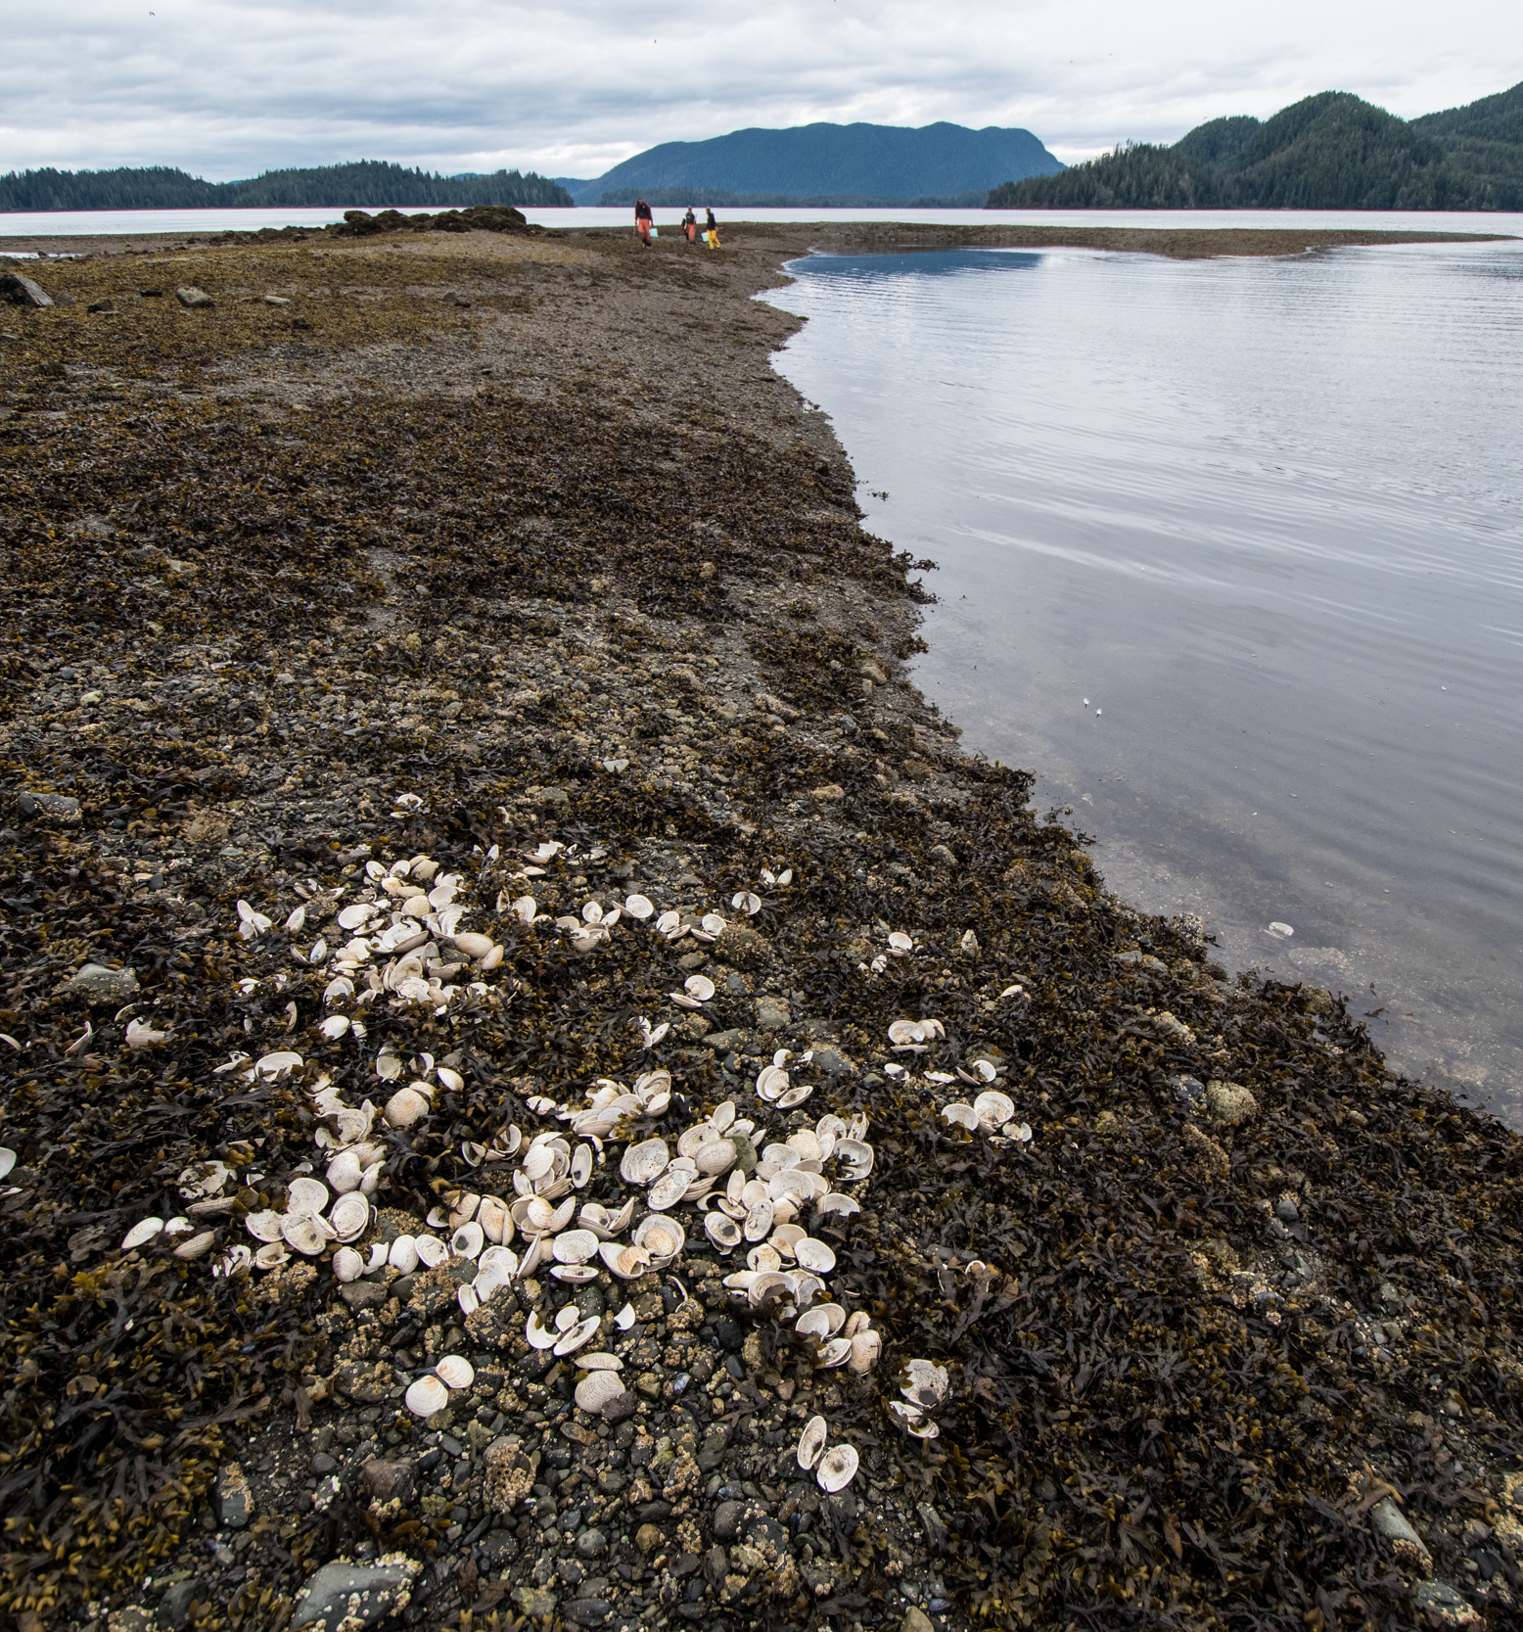
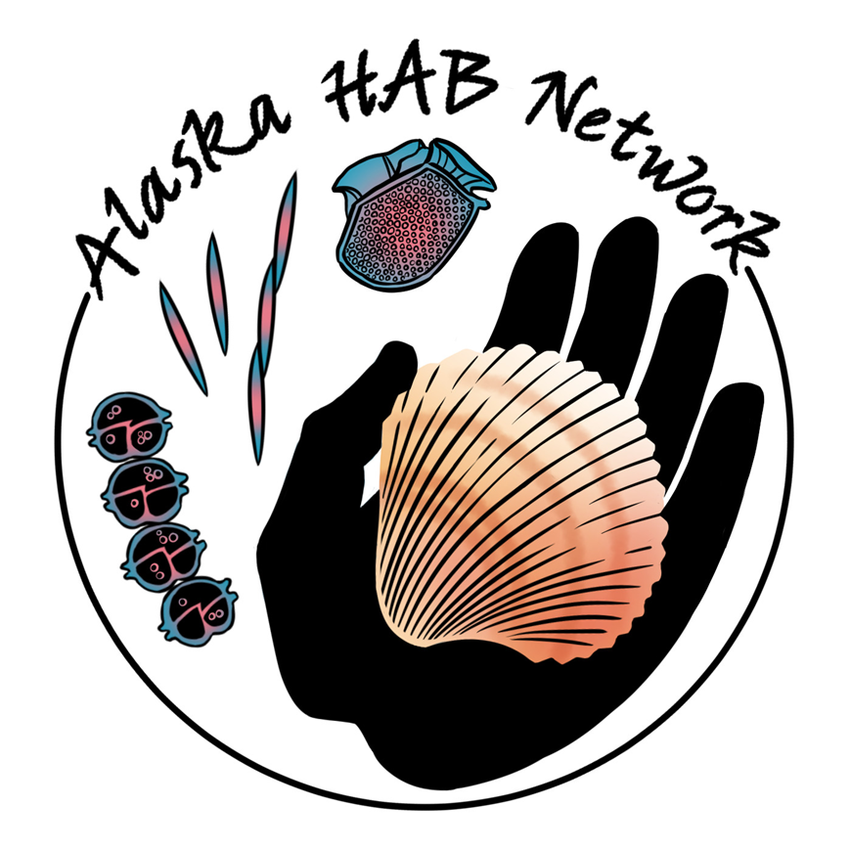
Alaska HAB Challenges
Lack of statewide monitoring program/emerging threats
Response Coordination
Communications
Medical concerns in remote communities

Slide 11
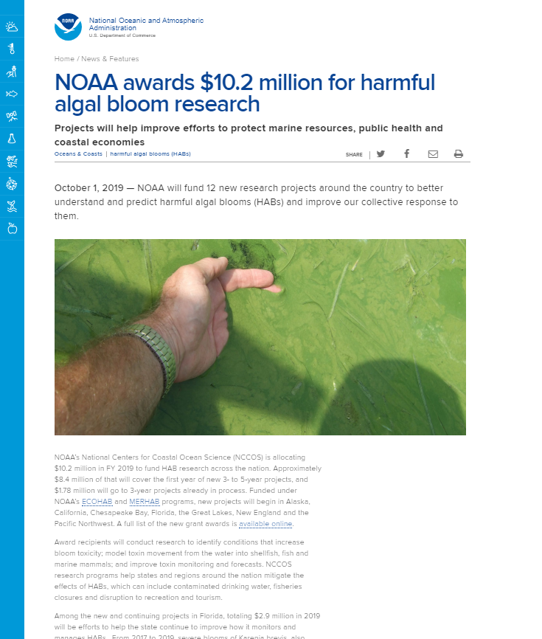
NCCOS HAB programs
Competitive funding
ECOHAB, MERHAB, PCMHAB
Research & tech development
Labs: Alaska, North Carolina,
South Carolina & Maryland
Example: CyAN partnership
Community monitoring
Phytoplankton Monitoring Network

