Slide 1
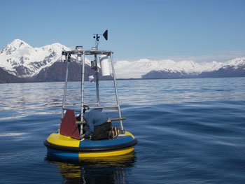
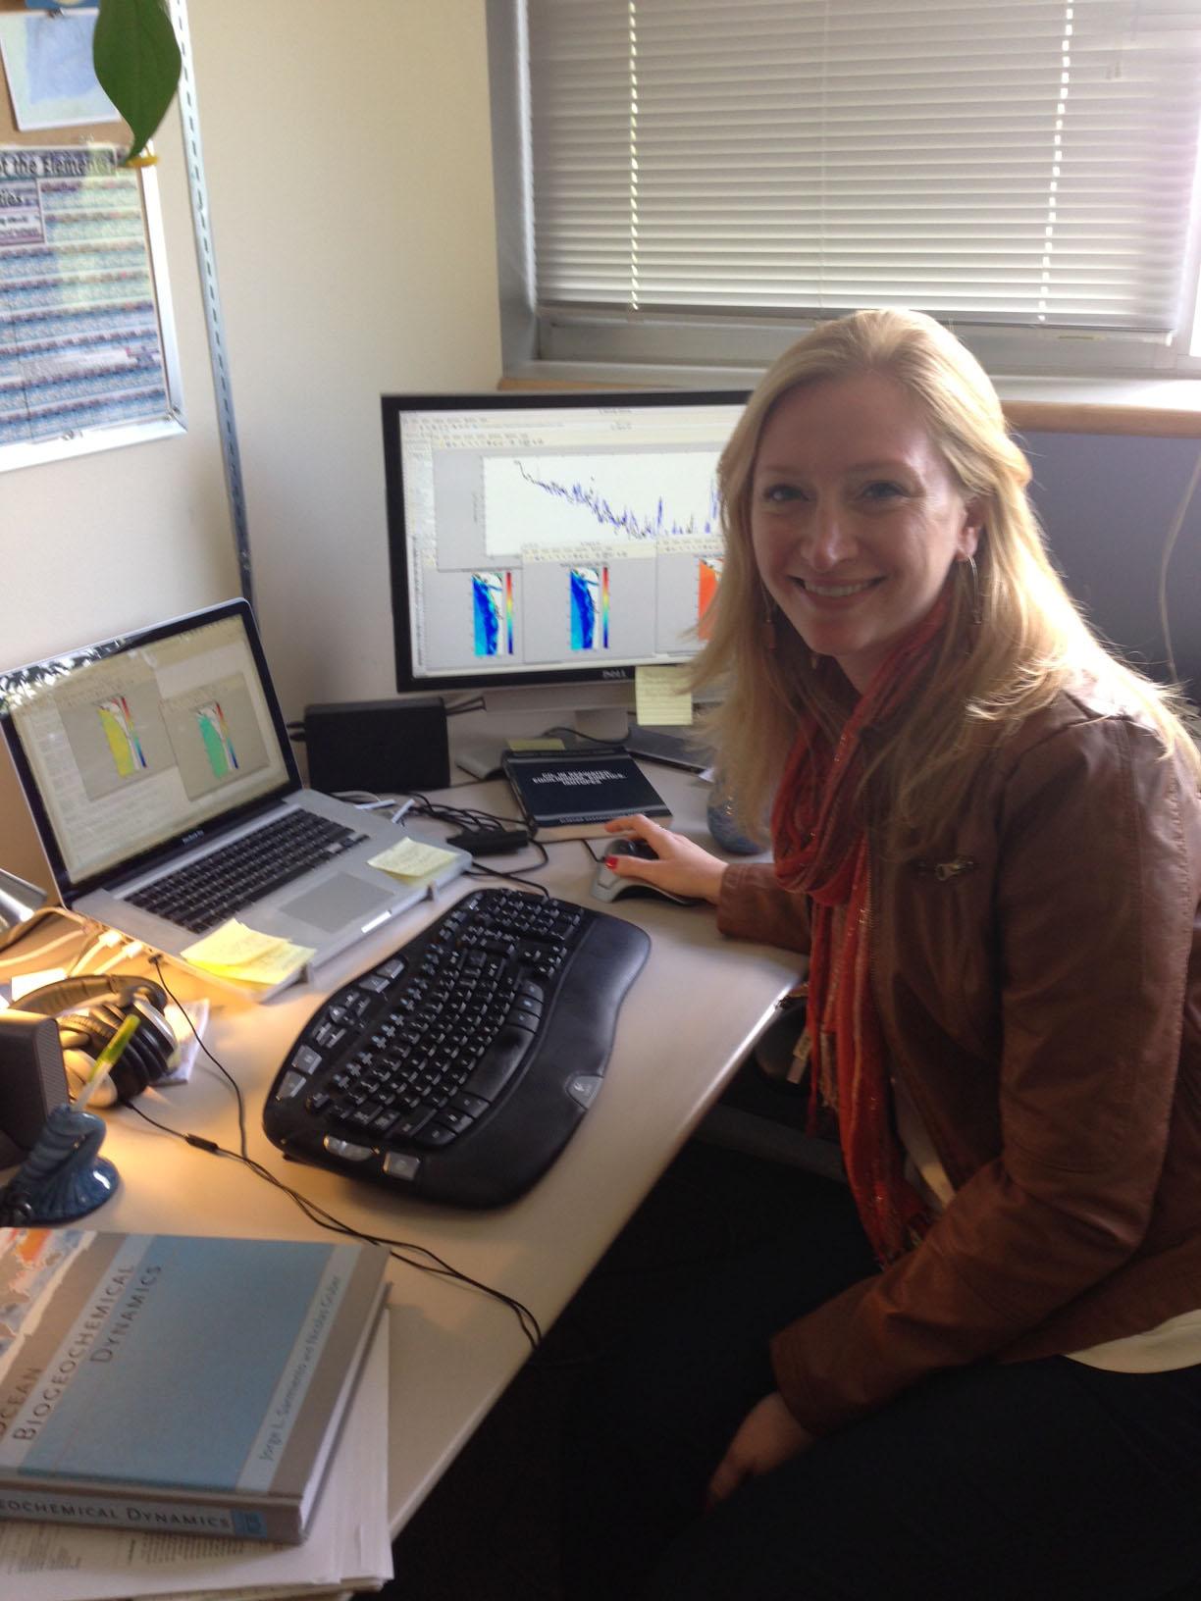
Modeling Strategy
For the Alaska Ocean Observing System

Slide 2
“IOOS has been thought of as primarily an observational system, with ad hoc support for modeling as a downstream data consumer.
IOOS Modeling Subsystem:
Vision and Implementation Strategy
Yet only models provide information with sufficient spatial and temporal resolution and extent to support many of the products needed by users.”

Slide 3
Past AOOS-supported modeling efforts
2005-06: UAF Modeling & analysis center: $520k, modeling comparisons for sea ice, RAMS & ROMS
2005-06: Moorings & sensors in Southeast, Aleutian Island passes & Bering Strait to support developing circulation models
2005-2010: PWS Demonstration Project; ROMS, WRF, NPZ & SWAN ; about $250-300k a year

Slide 4
Current AOOS-supported modeling efforts (2011-15)
PWS 24/7 ROMS ($100k/year) – Yi Chao
GOA PWS & CI WRF ($100k/year) – Peter Olssen
PWS hydrological model validation (@$75k over 3 years) – Scott Pegau
GOA ocean acidification model ($100k/1 year) – Jeremy Mathis
Downscale ocean climate models ($125k/2 years) – John Walsh
ABSI vulnerability assessment ($xk/1 year) – Axiom
AOOS Model Explorer on Ocean Portal
CI Modeling Group & support for NCOS ROMS
Beaufort Sea: obs to validate NCEP wave model

Slide 5
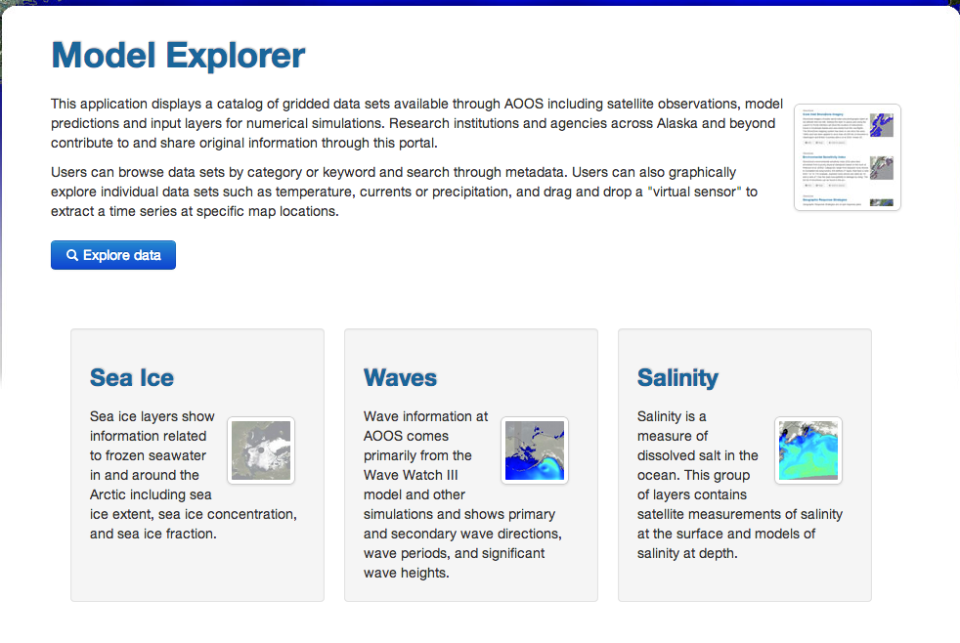
Existing physical oceanographic models in Alaska

Slide 6
Future AOOS-supported modeling efforts
Moving research to operational models
Enhancing existing models
Validating existing models w/observations
Creating products from existing models
Should we continue to devote $200k/year to modeling?
If so, what should we support?

