Slide 1
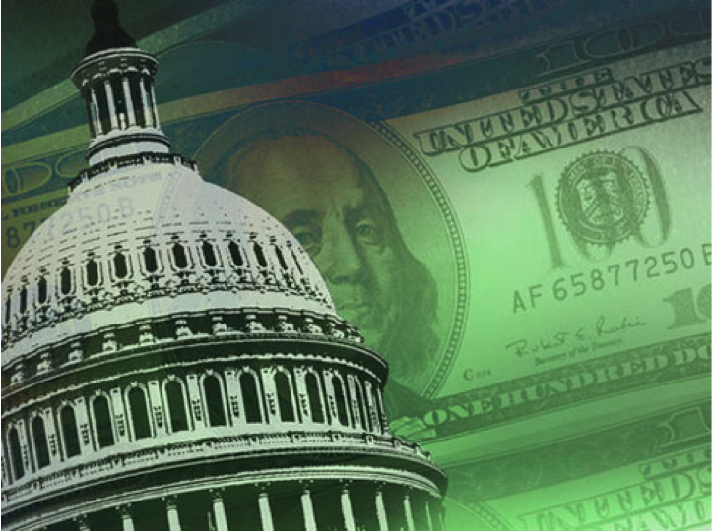
Ocean Acidification Funding:
From FOARAM to the Future
Jeremy T. Mathis
NOAA-PMEL and UAF-OARC
Ocean Acidification Stakeholder Meeting
December 2nd, 2014

Slide 2
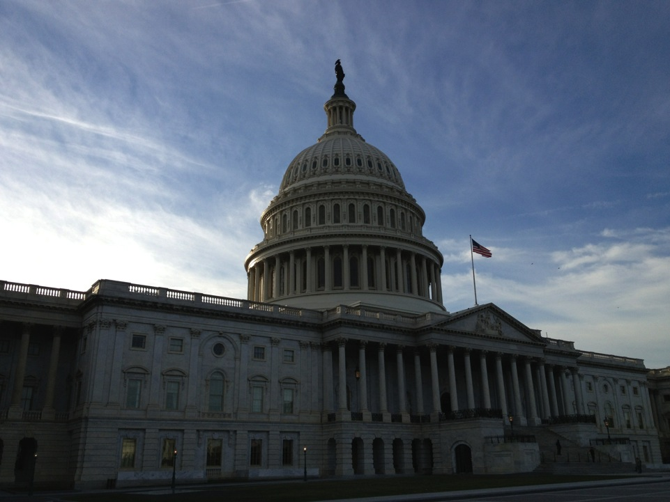
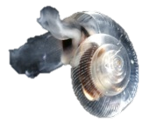
Federal Ocean Acidification Research and Monitoring (FOARAM) Act of 2009
Funding for ocean acidification research was established under SEC. 12406. of the Federal Ocean Acidification and Monitoring Act (FOARAM) to oversee and coordinate research, monitoring, and other activities consistent with the strategic research and implementation plan developed by the interagency working group on ocean acidification.
FOARAM ACT
NSF
NOAA
NSF
IWG - OA
USGS
NASA
FWS
EPA
BOEM
DOS
NOAA
NASA
NOAA Ocean Acidification Program (SEC. 12406)
Foster, direct, coordinate:
interdisciplinary research to improve understanding of ocean acidification;
establish a long-term monitoring program for ocean acidification
research to identify and develop adaptation strategies for conservation of marine ecosystems;
educational opportunities exploring the impacts of ocean acidification;
national public outreach
coordination of OA monitoring and impacts research with other appropriate international ocean science bodies

Slide 3

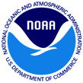
Your Tax Dollars and OA Research
Total NOAA funding = $24M
FY15 budget proposals:
  President ($15M), House ($6M) and Senate ($11M)
It is UNLIKELY that any new funds will be allocated in FY15.
2011
2012
2013
2014

Slide 4
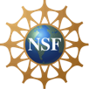
Your Tax Dollars and OA Research
Total NSF funding = $54M
There are no plans for any future dedicated OA calls. All proposals will be submitted to core programs.
All future projects will be competitively reviewed in core programs.

Slide 5
Your Tax Dollars and OA Research
Multiple Agencies Have Contributed Smaller Amounts
AOOS = $750K for moorings, cruises, and modeling
NPRB = $500K for monitoring
BOEM = $1.1M for projects in the Chukchi/Bering Sea and GOM
USGS = $5M for coral reef monitoring and arctic process studies
EPA = $1.2M for water quality monitoring
NASA = $4.4M through satellite observations and process studies
Total = $12.8M (plus $78M from NOAA and NSF)

Slide 6
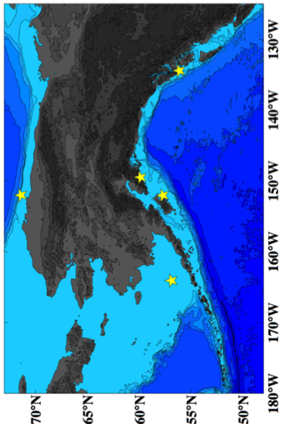

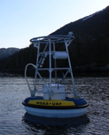
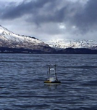
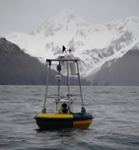
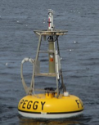

Closer to Home – Alaska State Funding
In 2012, the State of Alaska approved a $2.7M proposal to build an OA network.
The OARC was created to coordinate research and outreach activities and leverage support from a number of agencies to conduct broad-scale monitoring around Alaska.
Alutiiq Pride Shellfish Hatchery
Special thanks to Jeff Hetrick and Jacqueline Ramsey
SE Alaska
Kodiak
GAKOA
M2

Slide 7

Rapidly Expanding Knowledge
But What About Our Understanding?

Slide 8

Public Awareness of OA
Turley and Boot 2011

Slide 9


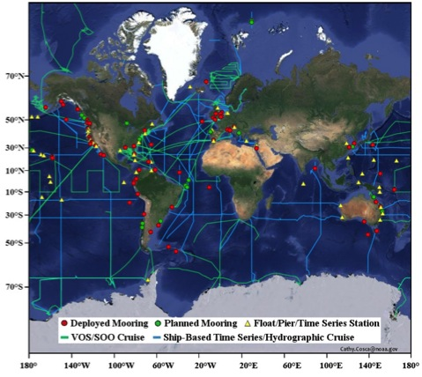





Creating an OA Observing System
Partnering with over 100 international scientists from 30 countries to build a global observing network for OA.
Deployment of 21 OA moorings with two carbonate system measurements.
http://www.goa-on.org
Global OA Observing Network (GOA-ON)

