Slide 1
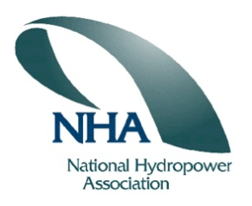
National Hydropower Association
Alaska Regional Meeting
August 2011, Girdwood, AK
Alaska Power & Telephone
Presentation on the
Yukon River Hydrokinetic Project at Eagle, AK
Notes:
Good morning ladies and gentlemen it is a pleasure to be here.
My name is Bob Grimm, I am the president of Alaska Power & Telephone.
Before I begin I would like to thank the NHA and the other sponsors for organizing this event.
I have a short presentation that describes our companies experience in the application of a hydrokinetic turbine generator operating in the Yukon River at Eagle, AK.
This project was undertaken in an effort to determine the potential of the new technology to provide energy from a renewable resource.
AP&T is committed to the development of renewable energy solutions and their application in the rural Alaskan communities that it serves.
Over the years AP&T has implemented several renewable energy projects that have replaced a majority of its diesel generation and it continues with this effort by looking for new opportunities and evaluating new renewable energy technologies.

Slide 2
Yukon River Hydrokinetic Project
Multi-year project to perform:
Permitting
Studies
Engineering
Manufacturing
Application
Evaluation
Permitting
AK DNR
US FWS
USACOE
FERC
Studies
Energy
Survey
Potamological
Biological
Engineering
Management
Technical solutions
Deployment/Recovery
Anchoring/Mooring
O&M procedures
Manufacturing
Turbine
Barge
Anchors
Power conversion
Support
Application
Construction
Installation
Commissioning
O&M
Monitoring
Evaluation
Performance
Expense
Alaska Regional Meeting August 2011
Notes:
The concept for the project was developed over a decade ago and plans were made to install the equipment at that time.
However the project was shelved for several years until 2006 when a request was made for funding to the Denali Commission.
The funding request was for the multi-year study to evaluate the application of a hydrokinetic turbine generator integrated into the power system of Eagle.
The funding was awarded in 2007 and project activities commenced in the fall of that year.
Previous permits were updated and scientists and technicians were contracted to perform site studies.
A contract was issued for the turbine equipment and engineering activities were underway to design the project facilities.
In early 2009 it was necessary to replace the turbine equipment supplier and New Energy was selected to provide the turbine.
In 2009 an additional funding request was made to the Denali Commission and in 2010 the additional funding was granted.
In 2010 the equipment was deployed and commissioned.

Slide 3
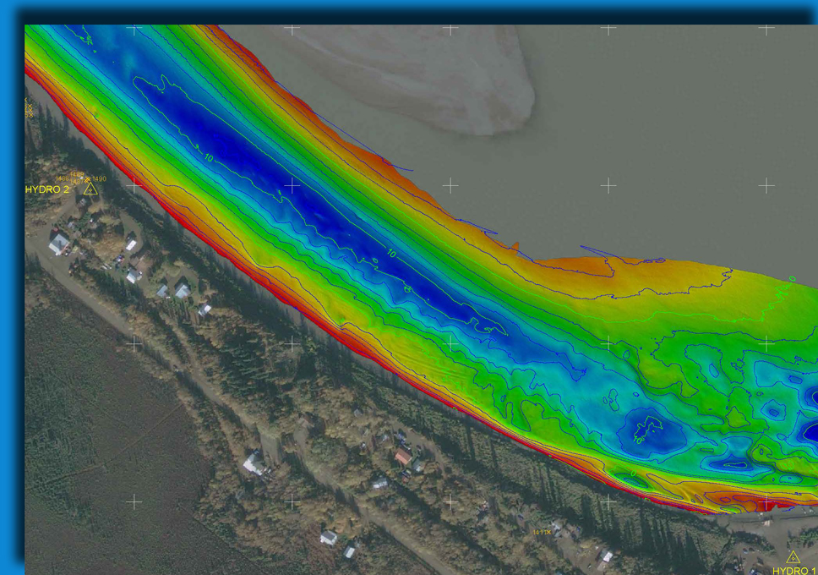
Yukon River Hydrokinetic Project
Facts:
Funded by the Denali Commission
$1.6 mil grant awarded in 2007
$1.5 mil grant awarded in 2010
Administered by the Alaska Center for Energy and Power
Installed and commissioned in 2010
Barge mounted New Energy EnCurrent 25kW turbine
AC-DC-AC power conversion
Output 3Ø, 60Hz power exported to 7200V Eagle distribution system
Relocating in 2012 to the ACEP Nenana Test Facility on the Tanana River for further studies
Alaska Regional Meeting August 2011
Notes:
The equipment operated successfully but was taken out of service after sustaining serious damage from the impact large debris during a heavy river drift event.
The equipment was repaired and put back into service only to be seriously damaged again ten days later in another heavy drift event at which time the equipment was taken out of service for the balance of the operating season.
In early 2011 it was decided to work in cooperation with ACEP and a proposal was drafted and submitted to the Denali Commission seeking their approval to move the equipment to the ACEP test facility in Nenana for further studies.
This summer the Denali Commission approved this rescope of the project and today activities are underway to demobilize the equipment from Eagle and transport it to Nenana.

Slide 4
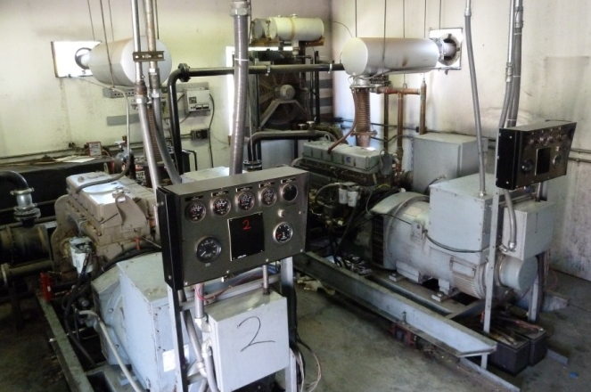
Yukon River Hydrokinetic Project
Importance to Alaskans
Potential renewable energy resource
Reduce dependence on costly diesel powered generation facilities
Increase sustainability of smaller Alaskan towns and villages by reducing economic burden of fossil fueled generation
Similar technology to tidal generators
Technical solutions may be applicable to both models
Unique factors about the project
One of the first of its kind in Alaska
First of its kind in Alaska to be fully integrated into the local utility grid
First its kind to provide electricity to an isolated Alaskan community
Alaska Regional Meeting August 2011
Notes:
AP&T is determined to find the ways and means to reduce its dependence on fossil fuels for generation of electrical power.
The hydrokinetic turbine is a technology that has great promise to meet this goal.
The success of AP&T in its deployment and operation of this technology in Eagle points to its viability.

Slide 5
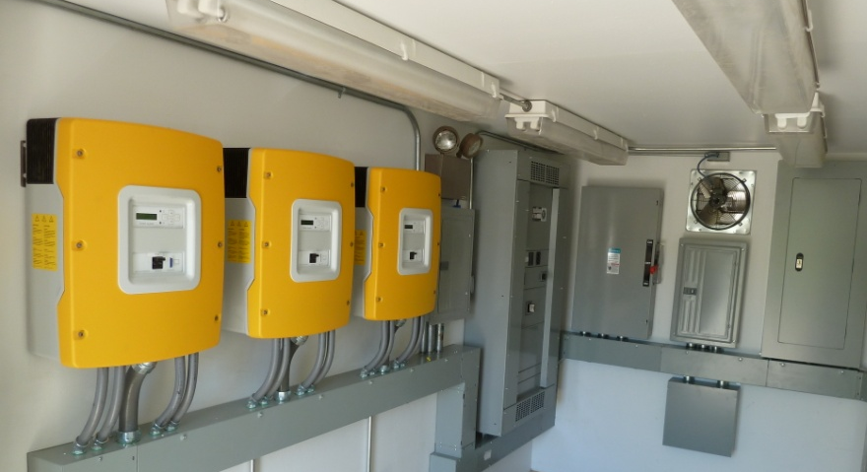
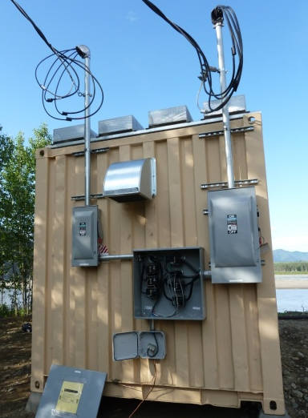
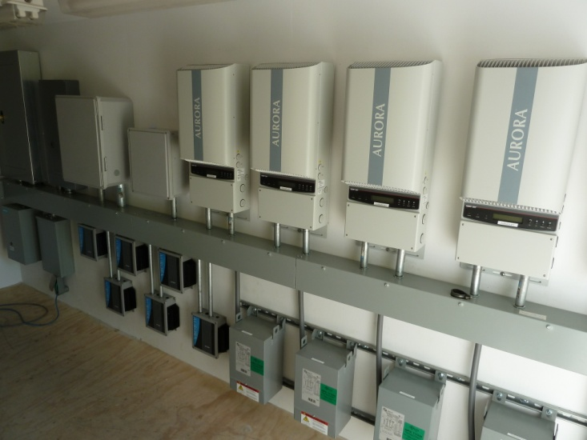
Yukon River Hydrokinetic Project
Project Successes
Performance and reliability of the technology
Turbine generator
Barge
Power generation, both in:
Parallel mode auto-synchronizing with diesel powered generation system, and
Standalone mode supplying electricity to an isolated section of the Eagle grid.
Potamological studies and surveying performed by TerraSond
Biological studies performed by the University of Alaska – Fairbanks and BioSonics
Cooperation of AP&T with the consultants, technology developers and equipment suppliers
Anchor
Deployment and recovery
Power conversion and integration
Control and communication
Alaska Regional Meeting August 2011
Notes:
The Eagle project was the first of its kind in Alaska to fully integrate the hydrokinetic generation into an existing electric power utility.
The successful parallel and stand alone operation of the hydrokinetic system providing power to the existing generation system proves that the power conversion technology is robust and dependable.
Our experience shows that the operation of this technology has very low impact on the river environment.
Concurrent laboratory studies have shown that the EnCurrent vertical axis cross flow turbine has negligible impact on fish.

Slide 6
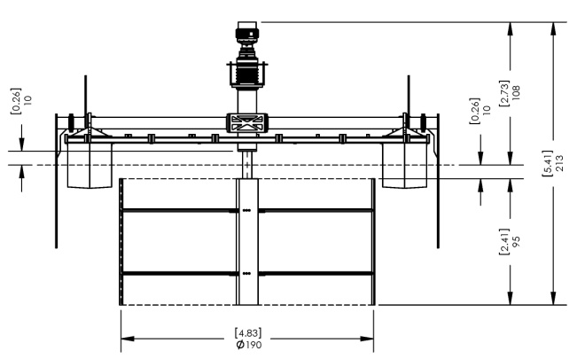
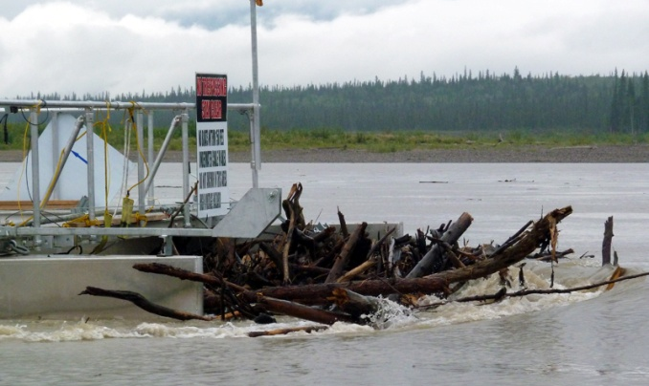
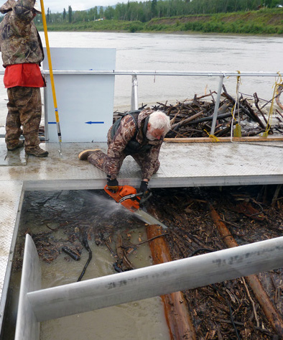
Yukon River Hydrokinetic Project
Lessons learned
Technology
Vertical axis cross flow turbine appears to have negligible impact on fish
Careful subsurface power cable routing critical to minimize failures
Number of subsurface mooring lines should be minimized
Turbine performance dramatically effected by river turbulence
Operations
Challenges of working with a powerful force of nature
Challenges of operating the technology in a remote location
Challenges in the logistics of rapidly providing necessary O&M support forces
Maintenance
Challenges associated with periodic debris ‘drift’ on the river
Susceptibility of the equipment to fouling and damage
Difficulty in managing the large submerged and hidden neutrally buoyant objects
Requirement for a large crew to be available to remove heavy accumulations
Maintenance expenses at the site far exceed the value of the modest generation revenue
Alaska Regional Meeting August 2011
Notes:
However it is clear from our experience that the ultimate success of this technology will be sensitive to the location that the technology is applied.
It turns out that operating this hydrokinetic device in the middle of the Yukon has proved not to be economical at this time.
However there are potential sites near other communities that are served by AP&T where this technology may be successfully utilized.
These sites include both river and tidal locations.
And throughout Alaska there are many communities that may be well served by the application of a hydrokinetic turbine generator.
With the continued study of this technology by organizations like ACEP it is possible that the means can be discovered to mitigate the recognized challenges.
Thank you ladies and gentlemen that concludes my presentation.

